Slide 1


Test Automation with Selenium & TestNG
Why Should We Automate ?
How Selenium & TestNG Solve Modern Testing Challenges ?

Slide 2

What is Automation Testing?
Definition
Benefits
use of software tools to automatically execute test cases, compare results, and report defects
Regression test ,Speed, accuracy, and saving time & cost.
Statistics
Automation adopted by 88% of agile teams in 2023.

Slide 3




Why Selenium?
Open-source
Cross-browser
WebDriver API
Free, widely adopted (35% of companies). Supports cross-browser and platform testing.

Slide 4

Why TestNG?
TestNG is designed to cover all categories of tests: unit, functional, end-to-end and integration
TestNG is a testing framework that executes test cases and manages their execution lifecycle..
Integration
Seamlessly integrates with Selenium.

Slide 5
Test Cases :
Register Page
User Can Register Successfully
User Can not Register Successfully
Login Page
Login With Valid Credential
Login With Invalid Credential
Password
Forgotten Password With Invalid Email
Forgotten Password With Valid Email
Home Page
Hover over main categories and Subcategories Randomly
Hover over Main Categories
Hover over subcategories
Select Main Categories and Subcategories
select main category
select Subcategory
Validate home page links
Logged Users Could Select Different categories
Logged Users Could Search For Any Product
Currencies
Switch From Euro To Pound
Switch From Euro To USD
Switch From USD To Euro
Wishlist Page
Add item to Wishlist page.
Compare page
Add two items to Compare list & compare between them.
Delivery Address page
Cart Page
Empty Cart
Add Item To Cart
View the cart after adding an item Remove item from the cart
Checkout for item in the cart
Clear Cart
Newsletter page
Subscribe in Newsletter.
Address page
Try to delete default address.
Add new Address
Complete Order.
Add item to Cart.
Complete order.
Returns Page
Logged User Can Create Return Request

Slide 6
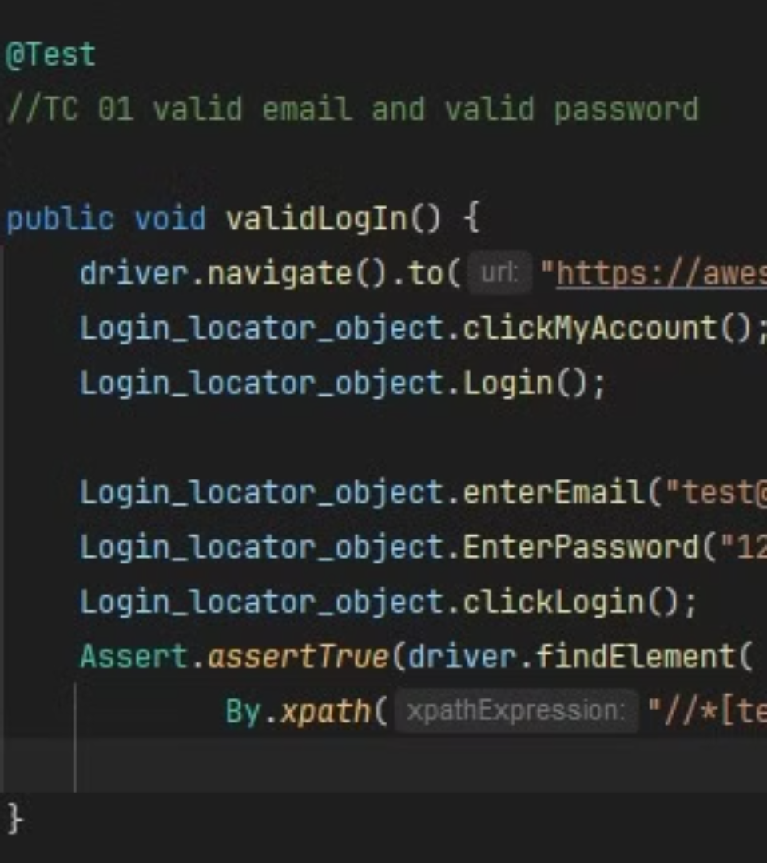
Demo: Code in Action
Sample Selenium TestNG Java test.
Automate login validation on a website.
Annotations, assertions, WebDriver utilities.

Slide 7
What is TestBase?
It is a simple approach to set up common initialization and cleanup in your tests.
We commonly categorize it as a Testing pattern.
The problem we are trying to solve here is the reuse of common behaviors. across test classes avoiding coding duplication and centralizing these actions at one point.
The application of a Base test class, in OO programming languages, is applied by the use of inheritance.

Slide 8

Centralized Setup
Definition
Benefits
A single source for test configuration, adhering to the DRY (Don't Repeat Yourself) principle.
Improved Reusability
Better Maintainability
Greater Consistency
Example
Shared initialization and cleanup logic.

Slide 9
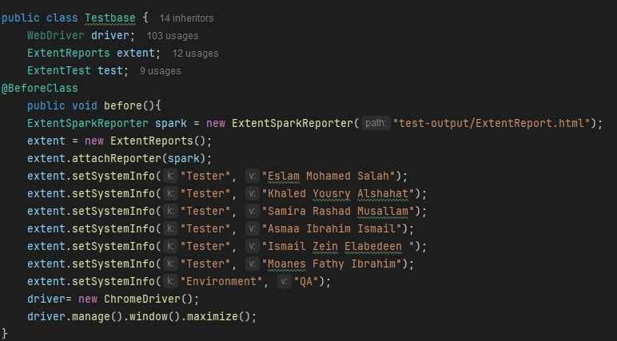
TestBase Code Example

Slide 10
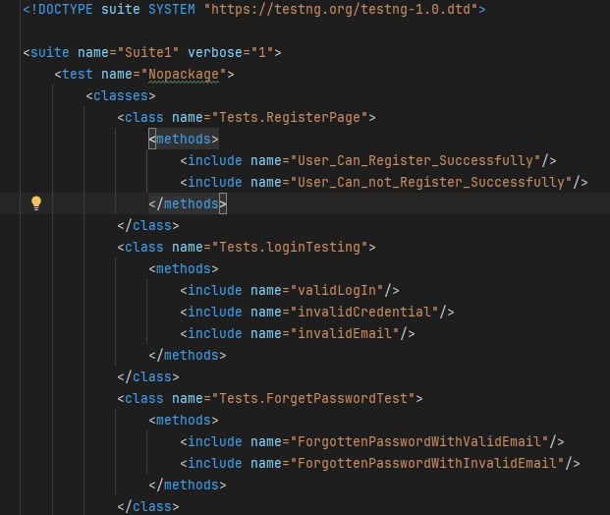



regression.xml
Configurations
Defines configurations for test suite execution.
Test prioritization
Includes test prioritization.
Grouping
Organizes test grouping.

Slide 11


Introduction to Extent Reports
HTML-based
Interactive reporting in Selenium. Customizable and visually engaging results.
Framework Integration
1
2
Works with TestNG/JUnit.

Slide 12
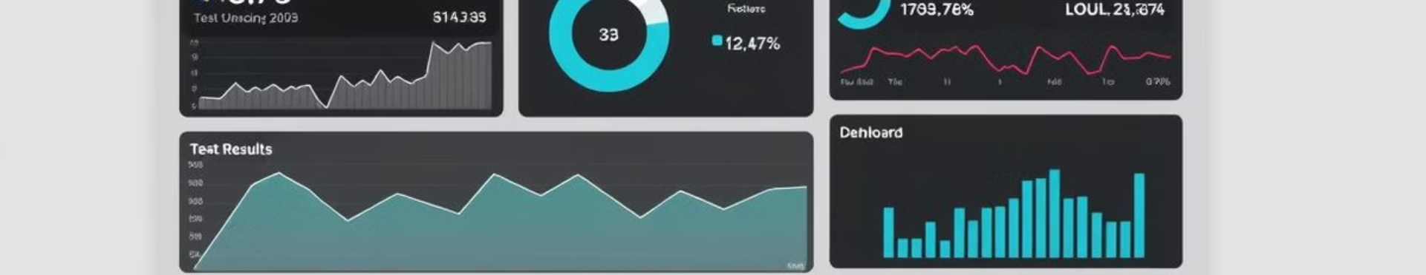


Key Features of Extent Reports
Interactive Dashboards
Historical Data
Detailed logs and test statuses.
Trend analysis over time.

Slide 13
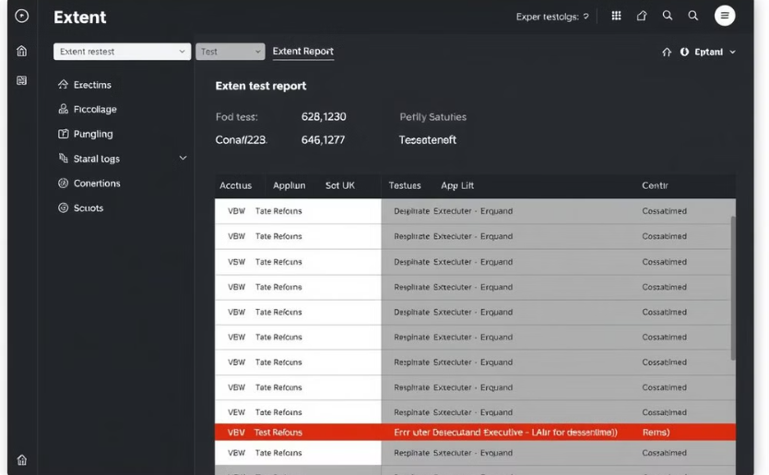
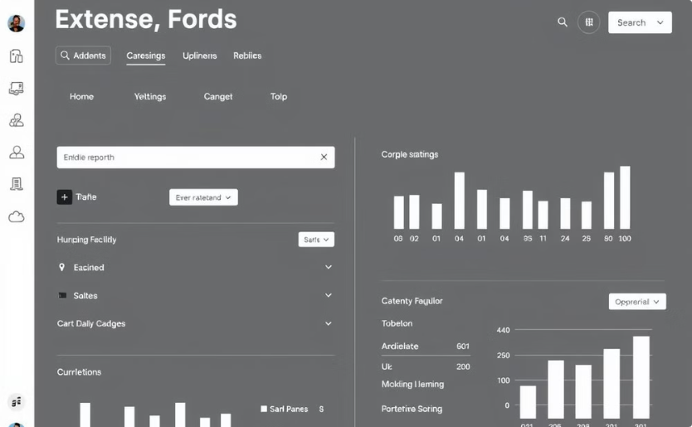
Visualizing Extent Reports
Test statuses
Interactive Navigation
Displays pass/fail statuses for each test, making it easy to identify problem areas.
Allows filtering and sorting of test results for efficient analysis.

Slide 14
Conclusion
Selenium & TestNG: essential tools for modern testing.
Adopt automation for faster, reliable testing.
Thank You! Contact info and links for resources.

Slide 15
Thanks👉🏻👈🏻

